Slide 1
Maths
Unit 2 – Numbers and Sequences
WALT: Use the relationship between repeated addition of a constant and multiplication to find and use a position to term rule.

Slide 2



WALT: Count on and count back in numbers of constant size, including fractions and decimals, and extend beyond zero to give negative numbers.
With support, I can find the position to term rule for a sequence.
Independently, I can find the position to term rule for a sequence.
I can find the position to term rule for a more complicated sequence.

Slide 3
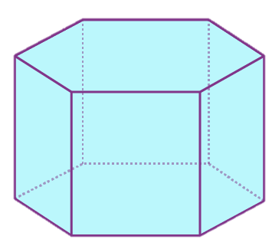
Retrieval Practice – 3D shapes.
WALT: Use the relationship between repeated addition of a constant and multiplication to find and use a position to term rule.
How many
Faces? –
Edges? –
Vertices? –
Does this 3D shape have?
8
18
12

Slide 4
Starter – What is the term to term rule for this sequence?
WALT: Use the relationship between repeated addition of a constant and multiplication to find and use a position to term rule.
7, 14, 21, 28, 35 …

Slide 5
The position to term rule…
WALT: Use the relationship between repeated addition of a constant and multiplication to find and use a position to term rule.
explains how to find the value of any number in a sequence.

Slide 6
Let’s find the position to term rule of the sequence from the starter.
WALT: Use the relationship between repeated addition of a constant and multiplication to find and use a position to term rule.
7, 14, 21, 28, 35 …
Position | Term
1 | 7
2 | 14
3 | 21
4 | 28
5 | 35
6
How could we find the 6th term in the sequence?
How could we find the 100th term in the sequence?

Slide 7
Let’s find the position to term rule of the sequence from the starter.
WALT: Use the relationship between repeated addition of a constant and multiplication to find and use a position to term rule.
7, 14, 21, 28, 35 …
Position | Term
1 | 7
2 | 14
3 | 21
4 | 28
5 | 35
6
What is the position to term rule for this sequence?
Multiply the position by 7.

Slide 8
Check your understanding
WALT: Use the relationship between repeated addition of a constant and multiplication to find and use a position to term rule.
Position | Term
1 | 11
2 | 22
3 | 33
4 | 44
5 | 55
6 | 66
What is the term to term rule for this sequence?
Add 11
What is the position to term rule for this sequence?
Multiply the position by 11
What is the 50th term in the sequence?
550

Slide 9
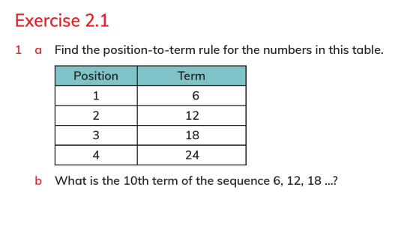
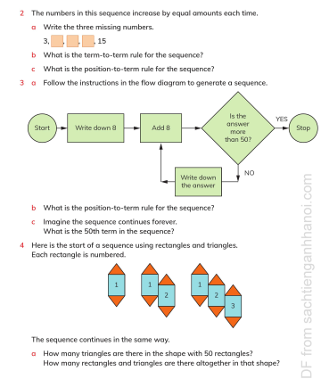
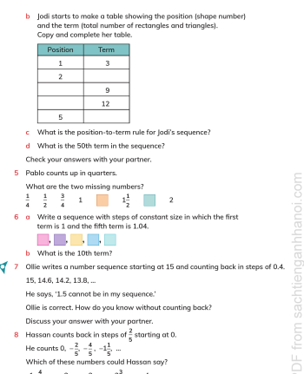
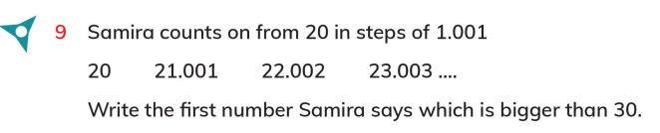
WALT: Use the relationship between repeated addition of a constant and multiplication to find and use a position to term rule.
LB Page 23 - 26

Slide 10
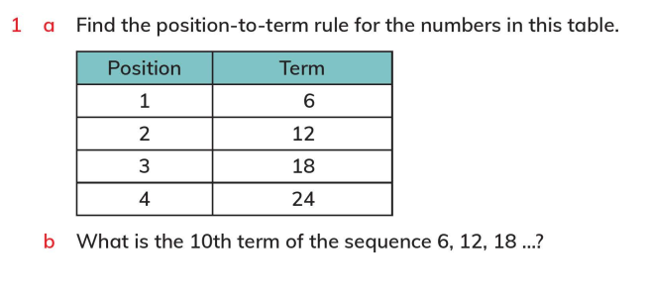
WALT: Use the relationship between repeated addition of a constant and multiplication to find and use a position to term rule.
Multiply the position by 6
60

Slide 11
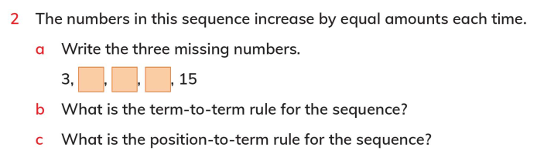
WALT: Use the relationship between repeated addition of a constant and multiplication to find and use a position to term rule.
6
9
12
Add 3
Multiply the position by 3

Slide 12
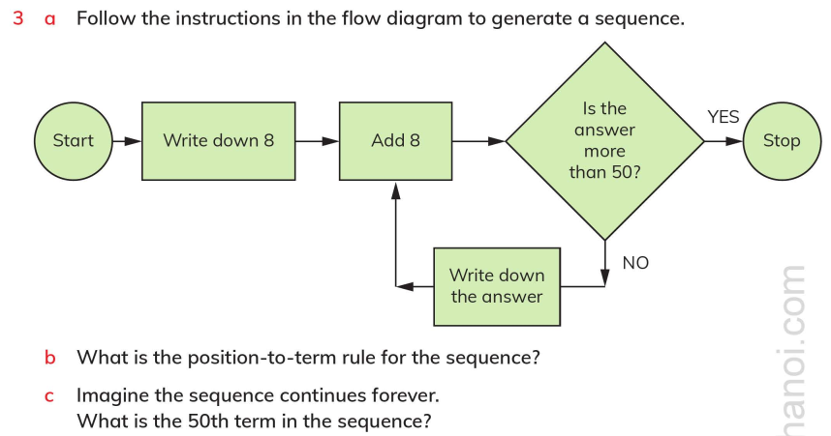
WALT: Use the relationship between repeated addition of a constant and multiplication to find and use a position to term rule.
8, 16, 24, 32, 40, 48
Multiply the position by 8
400

Slide 13
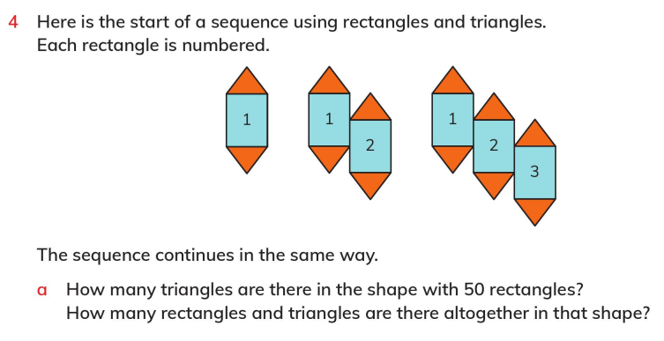
WALT: Use the relationship between repeated addition of a constant and multiplication to find and use a position to term rule.
100
150

Slide 14
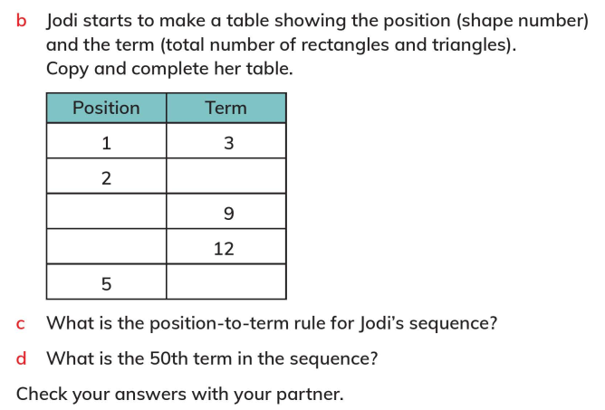
WALT: Use the relationship between repeated addition of a constant and multiplication to find and use a position to term rule.
6
3
4
15
Multiply the position by 3
150

Slide 15
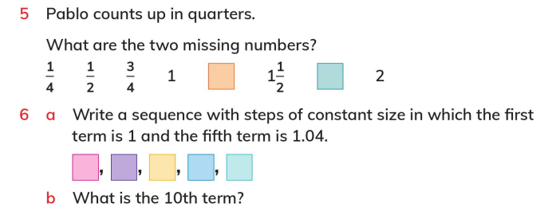
WALT: Use the relationship between repeated addition of a constant and multiplication to find and use a position to term rule.
1 ¼
1 ¾
1.04
1.03
1.02
1
1.01
1.09

Slide 16
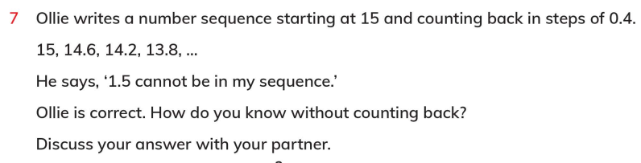

WALT: Use the relationship between repeated addition of a constant and multiplication to find and use a position to term rule.

Slide 17
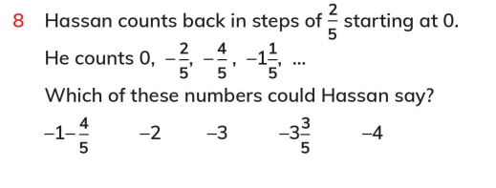
WALT: Use the relationship between repeated addition of a constant and multiplication to find and use a position to term rule.

Slide 18
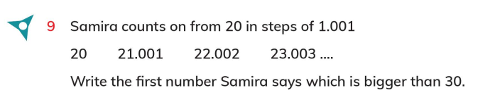
WALT: Use the relationship between repeated addition of a constant and multiplication to find and use a position to term rule.
30.01

Slide 19
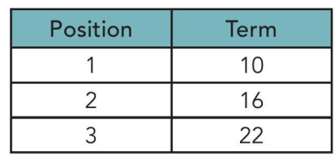
Plenary – What is the position to term rule in this sequence?
WALT: Count on and count back in numbers of constant size, including fractions and decimals, and extend beyond zero to give negative numbers.

Slide 20
WALT: Count on and count back in numbers of constant size, including fractions and decimals, and extend beyond zero to give negative numbers.
With support, I can find the position to term rule for a sequence.
Independently, I can find the position to term rule for a sequence.
I can find the position to term rule for a more complicated sequence.

